Slide 1

Project 1 – Crypto Tyler Boudart, Byeongho Choi, Augustine Chiu, Gerardo Palacios

Slide 2
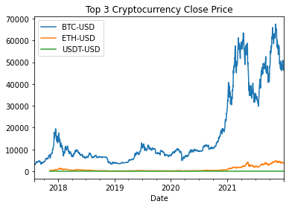
Why Bitcoin?
Leading cryptocurrency
Extremely volatile

Slide 3
ARIMA(p, d, q)
Three components:
Autoregressive - AR(p)
Predicts future values based on past values
AR(1): V_{T} = β₀ + β₁V_{t-1} + α_{t}
Integrated - I(d)
Difference of series
Used for non-stationary time series
Moving Average - MA(q)
Predicts future values based on past random shocks/errors
MA(1): V_{T} = β₀ + β₁α_{t-1} + α_{t}

Slide 4
GARCH(p, q)
Similar to the AR and MA components of ARIMA
Predicts volatility at a certain time period instead of value
Autoregressive conditional heteroskedasticity – ARCH(q)
Predicts variance of the ARIMA error term using past observations
Generalized autoregressive conditional heteroskedasticity – GARCH(p, q)
Predicts variance of the ARIMA error term using past values of variance, along with the ARCH component if q doesn't equal 0

Slide 5
Methodology 1
Use auto_arima function from pmdarima package to fit an ARIMA model on the log returns series
1
Build GARCH model on the ARMA residuals using arch_model from the arch package
2
Forecast 1 day out and add the forecasted value to the log returns series
3
Repeat 365 times
4

Slide 6
Methodology 1 (cont)
This process was very slow (500 simulations took over 11 hours)
Attempts at optimization
Batching
We do not think it is possible to batch with changing sigmas each time period
GPU
Quickly realized it wasn't a feasible without manually recreating the packages using NumPy. Numba does not allow the use of third-party packages
Forecast length
We could forecast more than 1 day out.
Significantly cut down on the number of times we have to fit the model while also preserving volatility
Results did not seem quite right

Slide 7
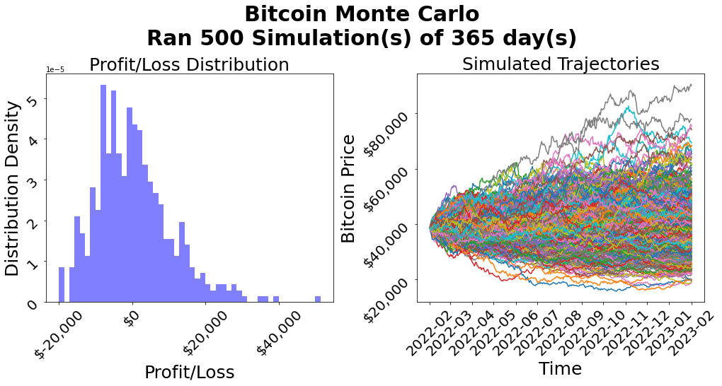
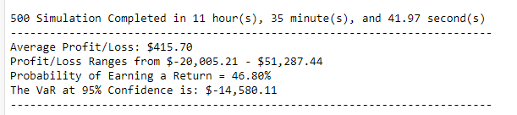
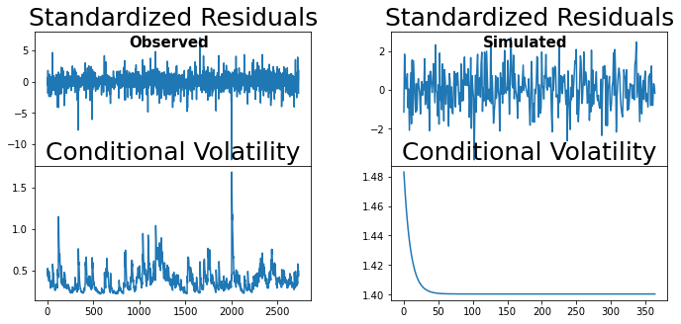
Methodology 1 (cont)

Slide 8
Methodology 2
Use auto_arima function from pmdarima package to fit an ARIMA model on the log returns of the observed series
1
Build GARCH model on the ARMA residuals using arch_model from the arch package
2
Use the fitted model’s parameters and use the garch formula to forecast the next sigma Sigma = np.sqrt(omega + np.sum(alphas * (returns ** 2)) + np.sum(betas * (sigmas ** 2)))
Generate a return using the forecasted sigma
3
Repeat 365 times
4
This process was much faster (100 simulations took less than one minute)
Results appeared more in line with observed values

Slide 9
Returns
Return volatility is not homoscedastic and could be impacted be changes in, but not limited to:
Laws impacting markets (e.g. capital gains taxation)
Interest rate environment
War
Stock bubbles bursting
GARCH models assist in forecasting the variance at different time period
The predicted variance from GARCH is used as the variance for the return distribution for a specific time period
The returns variance is updated each time period

Slide 10
Asian Option
Uses average price offer specified time horizon as strike price
Type of average needs to be specified
arithmetic vs geometric
Low volatility
Example of 1 year option where value is based on quarterly period
arithmetic mean
Average Price = (P_{Q1} + P_{Q2} + P_{Q3} + P_{Q4})/4
Price at the end of each quarter
Call option's profit = Current Price – Average Price – Contract Cost
Put option's profit = Average Price – Current Price – Contract Cost
Notes:
https://www.investopedia.com/terms/a/asianoption.asp

Slide 11
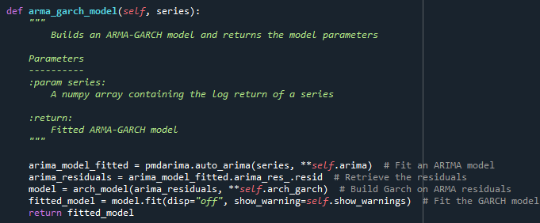
ARIMA
Notes:
The code was organized into multiple classes that were all encapsulated in the Monte Carlo Class. There were 6 key functions that were core to the simulations. First, is fitting an arma-garch model to the observed time series. This was accomplished by using two third-party packages called pdmarima and arch. These two packages allowed us to build an arma model and use the residuals to build the garch. This was run once at initialization

Slide 12
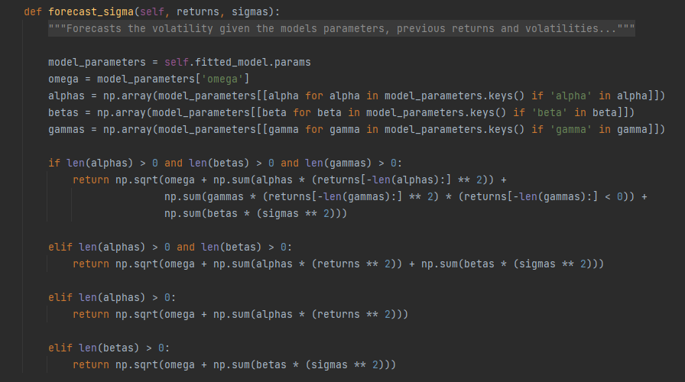
Forecast Sigma

Slide 13
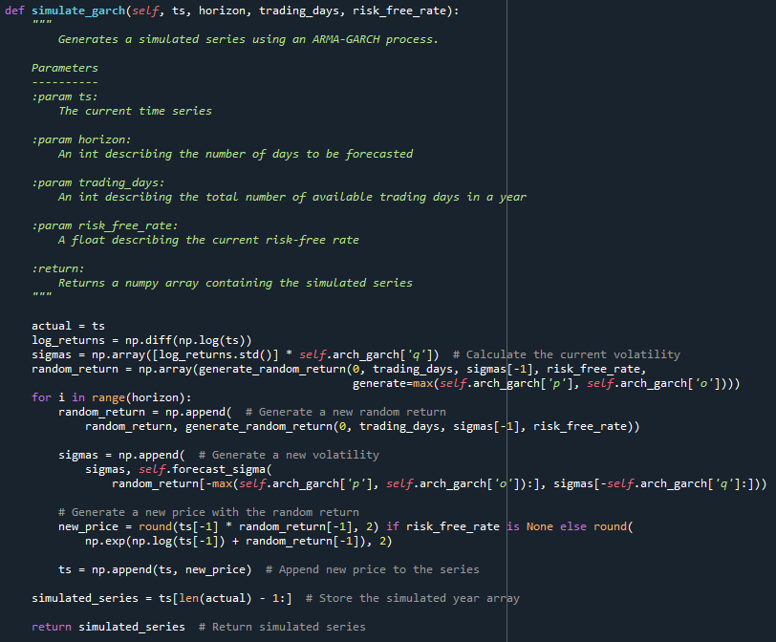
GARCH

Slide 14
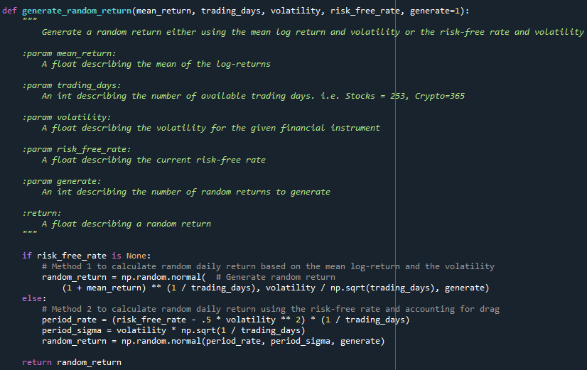
Generate Returns

Slide 15
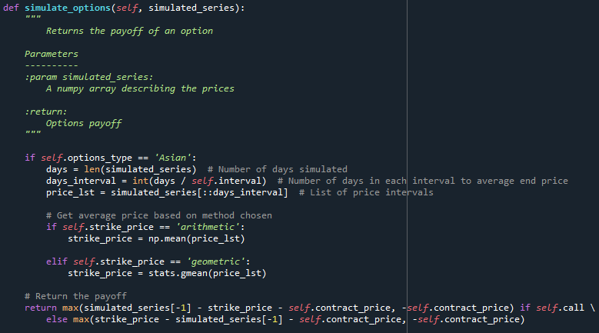
Options

Slide 16
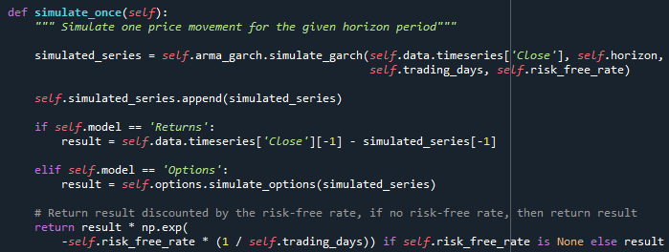
Simulate Once

Slide 17
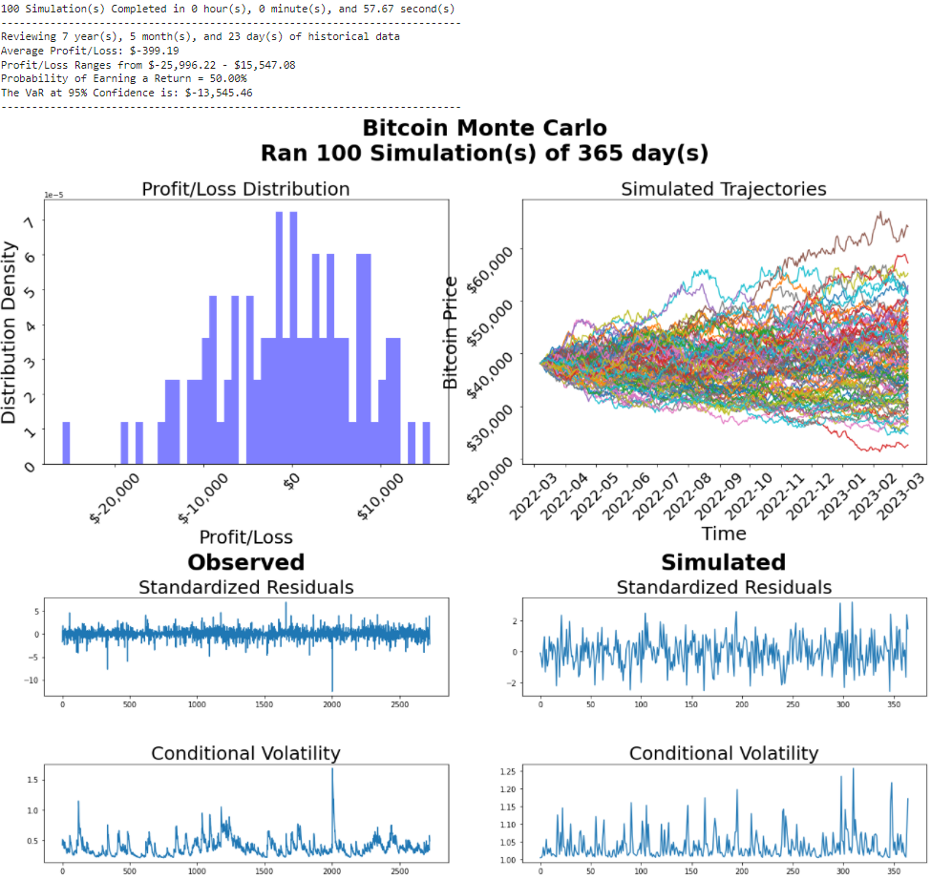
Results / Graphs

Slide 18
Conclusion
On average, investors lost money if holding Bitcoin for a year
The 95% VaR is a loss of about one third of the investment or about $13,500 (35% reduction in value)
Hold out the last year of data, run simulation for 365 days, and compare hold out to simulated results

